Slide 1
Visão por Computador
Image Segmentation
Luís Paulo Peixoto dos Santos

Slide 2
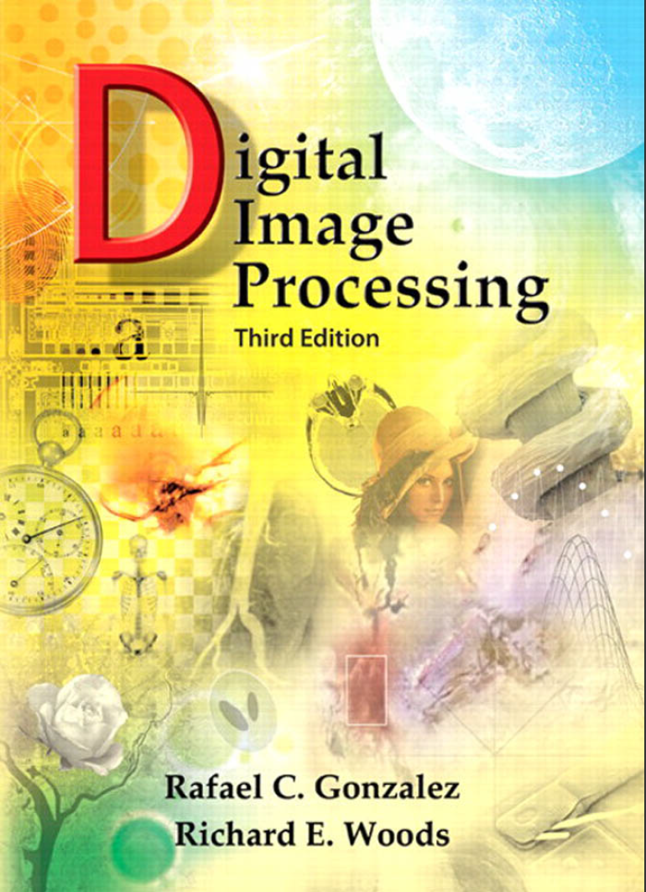
Bibliography
© 2008 by Pearson Education, Inc.
Pearson Prentice Hall
Pearson Education, Inc.
Upper Saddle River, New Jersey 07458
ISBN 0-13-168728-x
https://www.imageprocessingplace.com/
Capítulo 10

Slide 3
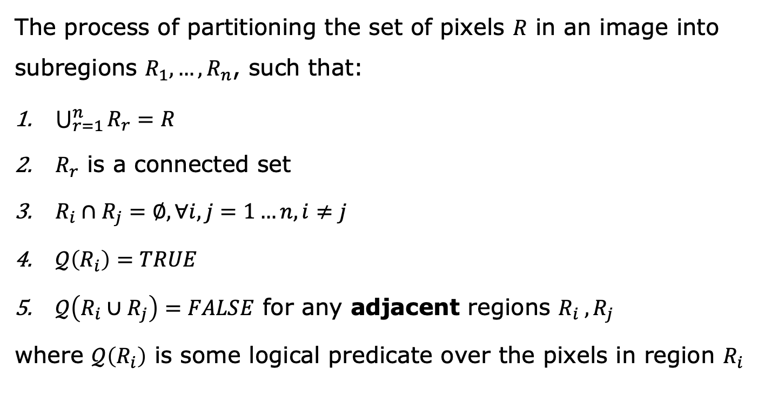
What is segmentation?
The process of partitioning the set of pixels $R$ in an image into subregions $R_{1}, …,R_{n}$, such that:
$\bigcup_{r=1}^{n}{R_{r}}=R$
$R_{r}$ is a connected set
$R_{i}∩R_{j}=∅, ∀i,j=1…n,i≠j$
$𝒬\left(R_{i}\right)=TRUE$
$𝒬\left(R_{i}∪R_{j}\right)=FALSE$ for any adjacent regions $R_{i} , R_{j}$
where $𝒬\left(R_{i}\right)$ is some logical predicate over the pixels in region $R_{i}$

Slide 4
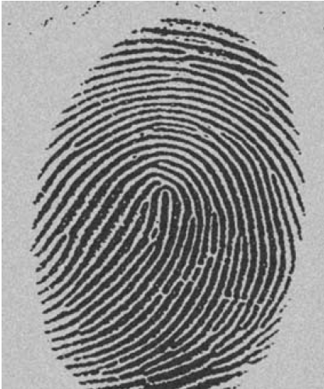
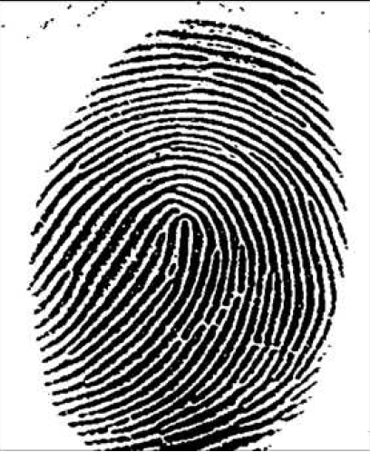
Image Segmentation

Slide 5


Image Segmentation
Edge Based
Region Based

Slide 6
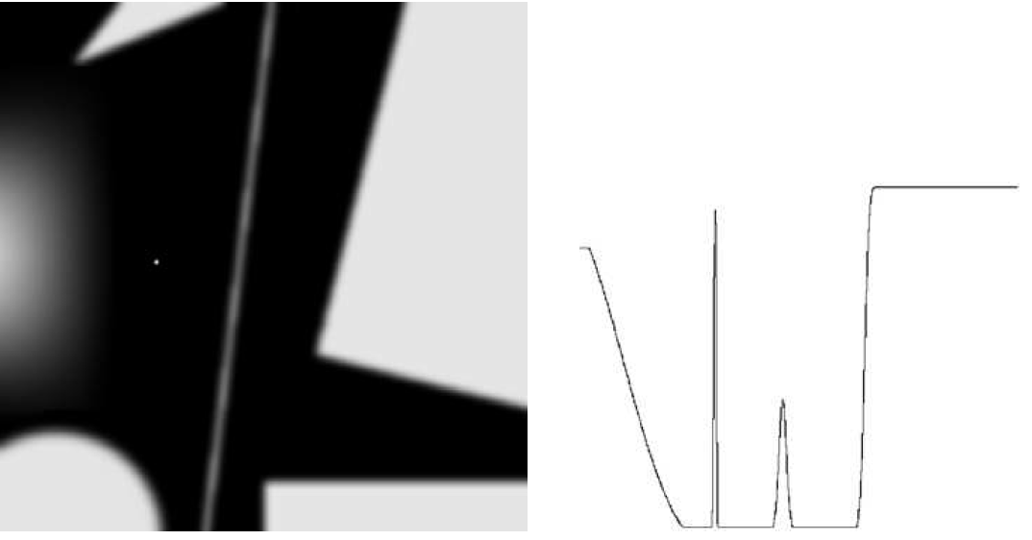
Edge Detection - Fundamentals

Slide 7
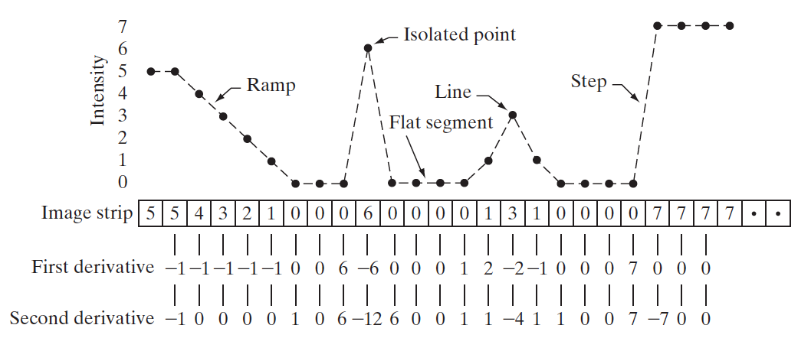
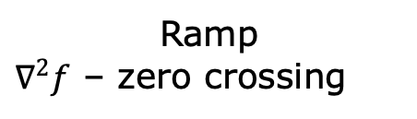
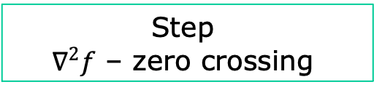
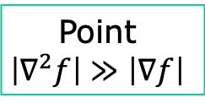
Edge Detection - Fundamentals
Ramp
$∇^{2}f$ – zero crossing
Point
$$\left|∇^{2}f\right|≫\left|∇f\right|$$
Step
$$∇^{2}f\text{ – }\text{zero} \text{crossing}$$

Slide 8
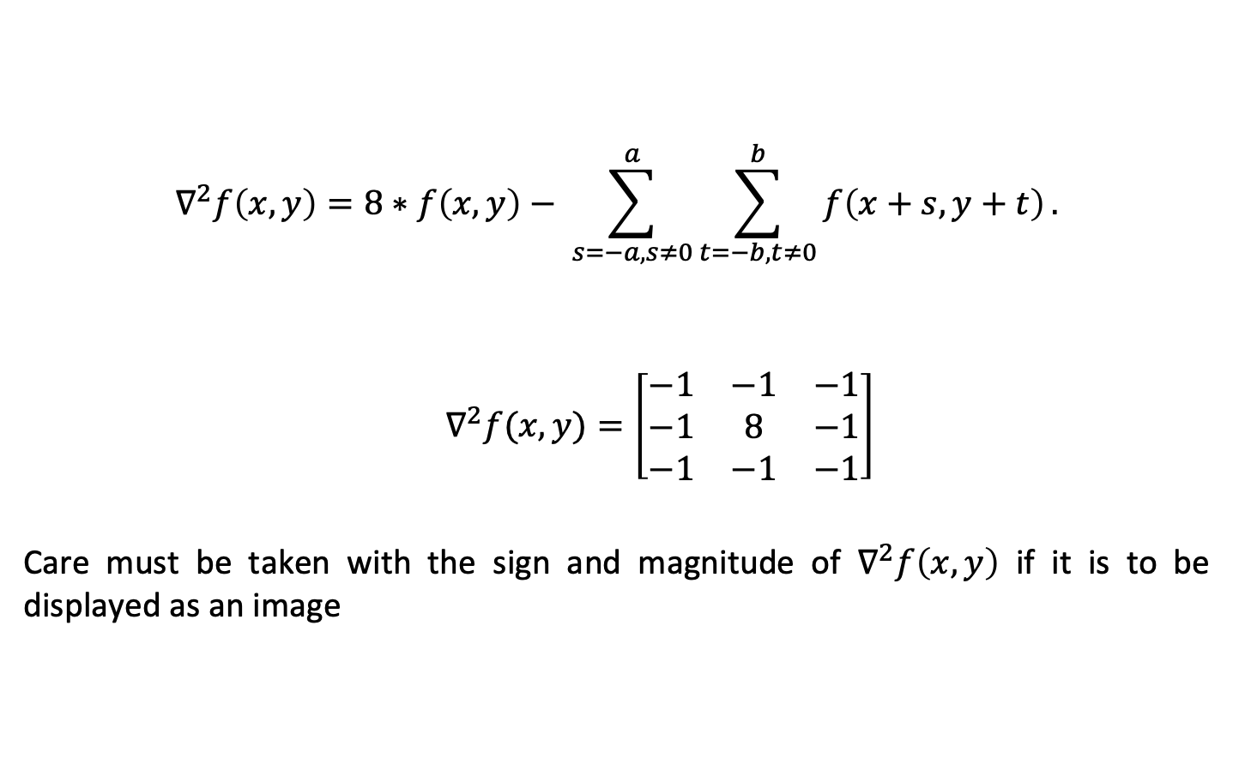
Laplacian Operator
$$∇^{2}f\left(x,y\right)=8∗f\left(x,y\right)− \sum_{s=−a,s≠0}^{a}{\sum_{t=−b,t≠0}^{b}{f\left(x+s,y+t\right)}}.$$
$$∇^{2}f(x,y)=\left[\begin{matrix}−1 & −1 & −1 \\ −1 & 8 & −1 \\ −1 & −1 & −1\end{matrix}\right]$$
Care must be taken with the sign and magnitude of $∇^{2}f\left(x,y\right)$ if it is to be displayed as an image

Slide 9
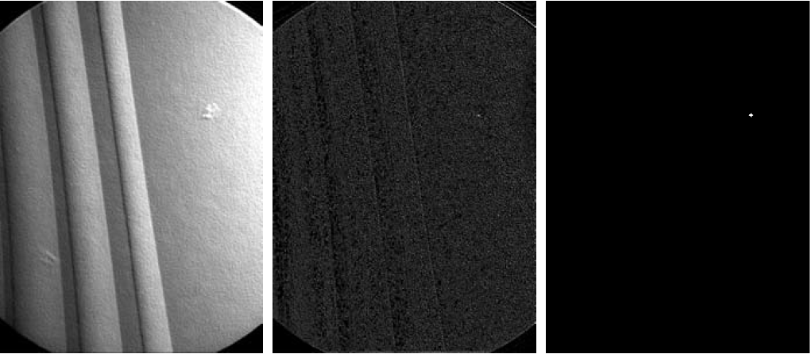
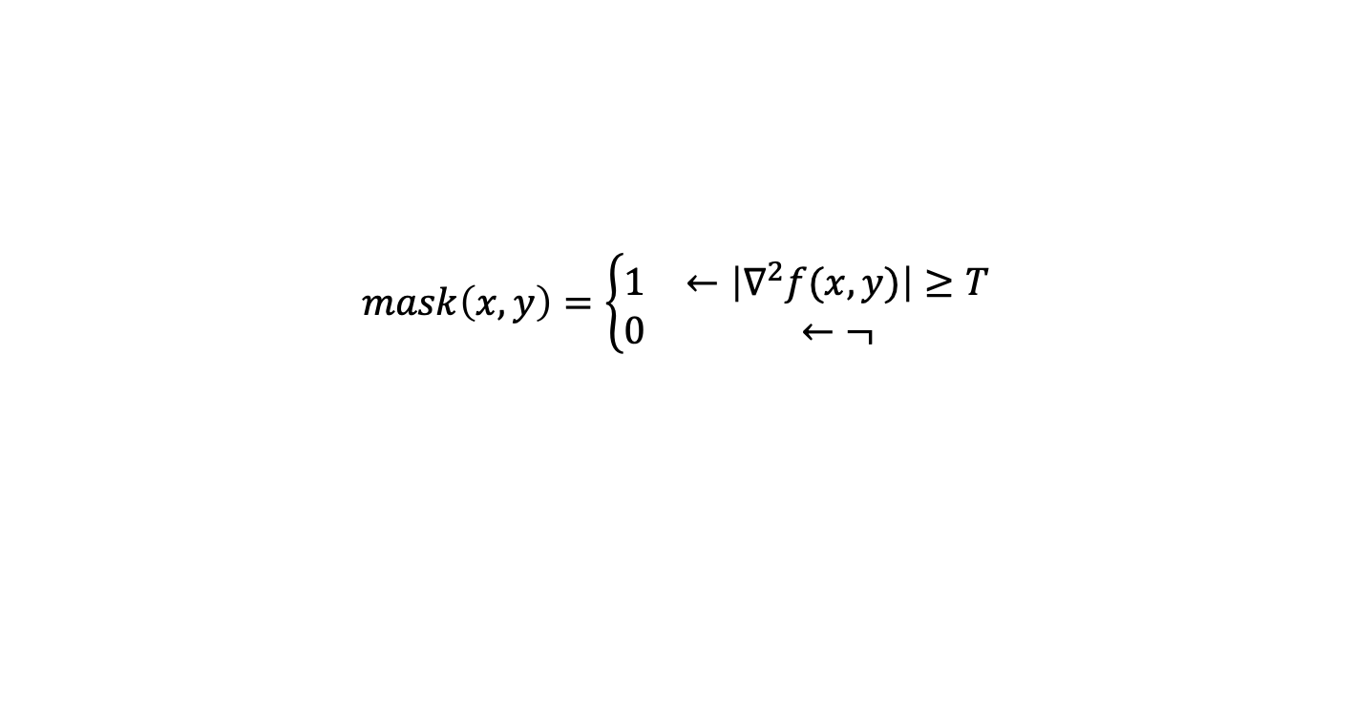
Point Detection
$$mask\left(x,y\right)=\left\{\begin{matrix}1 & ←\left|∇^{2}f(x,y)\right|≥T \\ 0 & ←¬\end{matrix}\right.$$

Slide 10

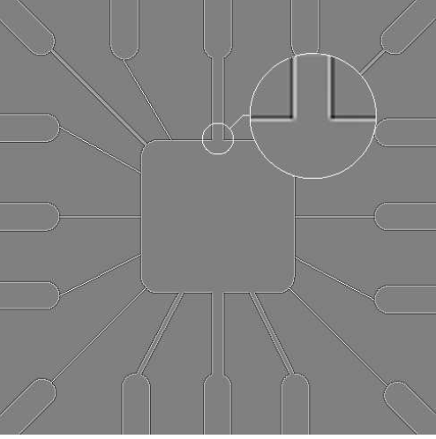
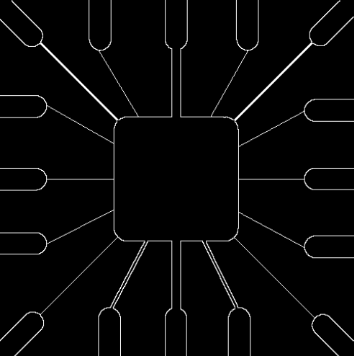
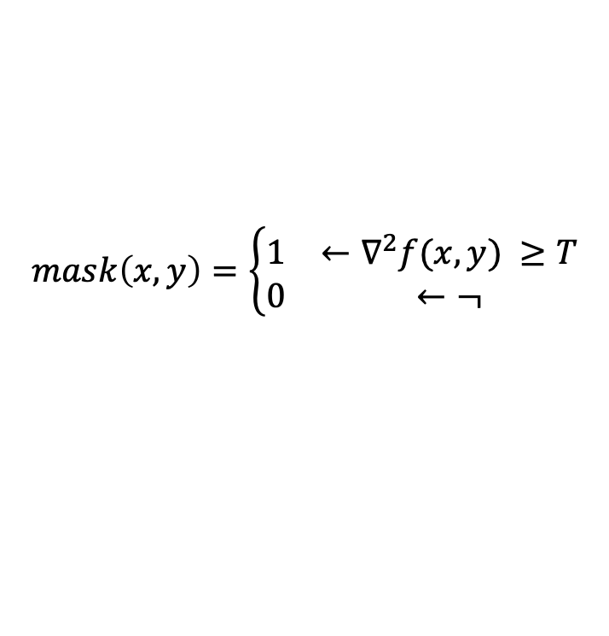
Line Detection
$$mask\left(x,y\right)=\left\{\begin{matrix}1 & ←∇^{2}f(x,y) ≥T \\ 0 & ←¬\end{matrix}\right.$$
Only positive values to avoid doubling the lines’ thickness.

Slide 11
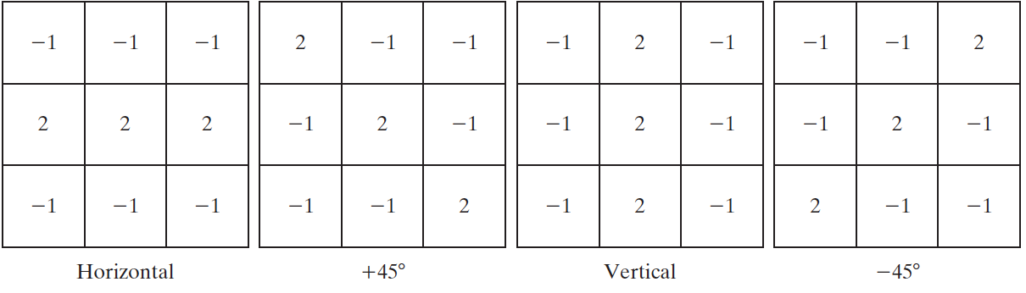
Line Detection
The previously seen Laplacian is isotropic (response independent of the lines’ directions)
Different anisotropic filters can be used to detect lines with given orientations

Slide 12
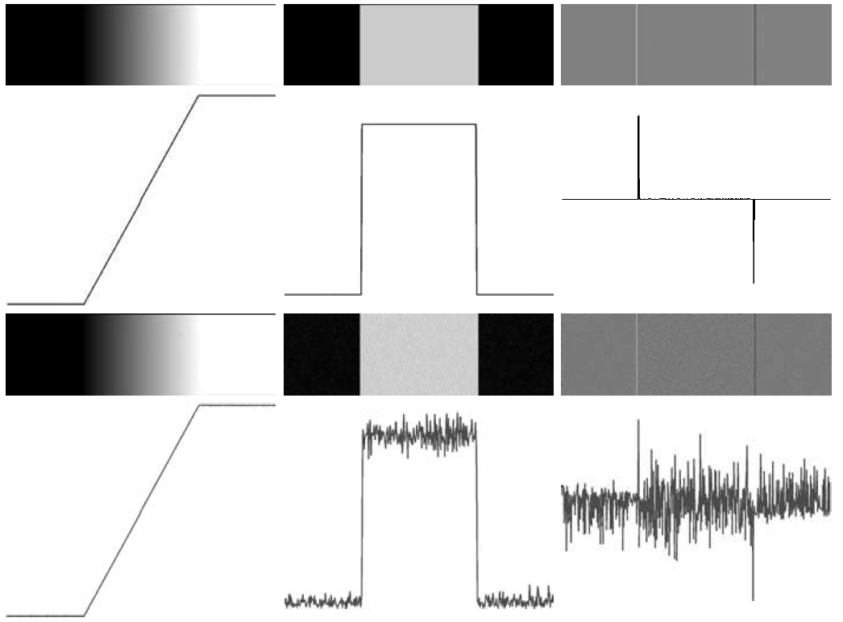
Impact of Noise (I)

Slide 13
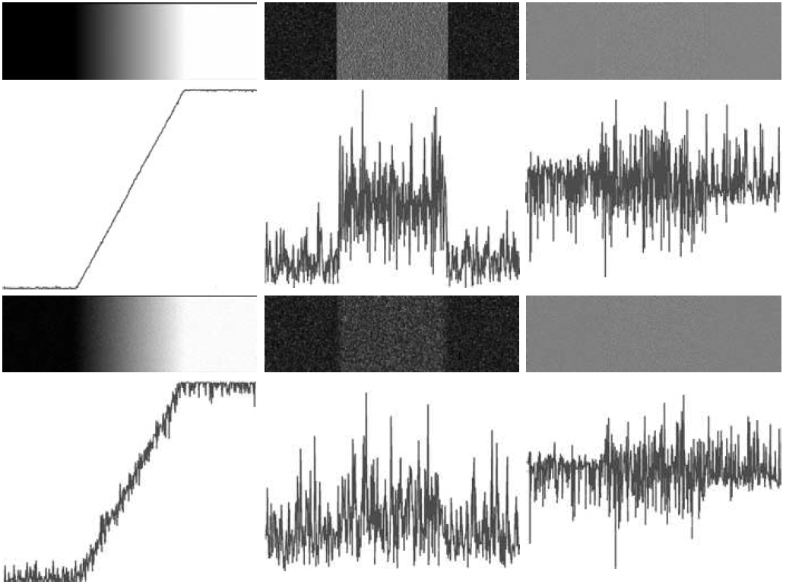
Impact of Noise (II)

Slide 14
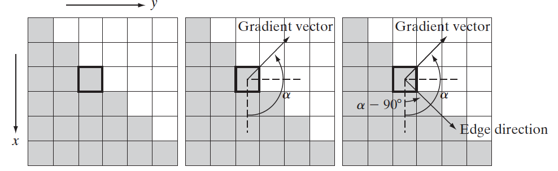
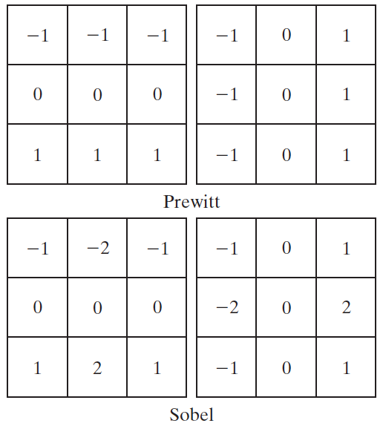
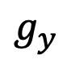
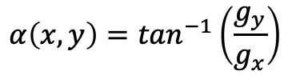
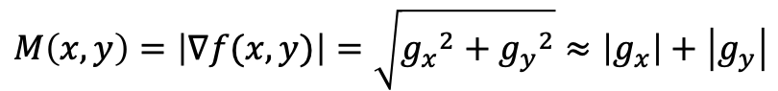
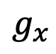
Gradient Operators
$$g_{x}$$
$$g_{y}$$
$$M\left(x,y\right)=\left|∇f(x,y)\right|=\sqrt{{g_{x}}^{2}+{g_{y}}^{2}}≈\left|g_{x}\right|+\left|g_{y}\right|$$
$$α\left(x,y\right)=\tan^{−1}\left(\frac{g_{y}}{g_{x}}\right)$$

Slide 15
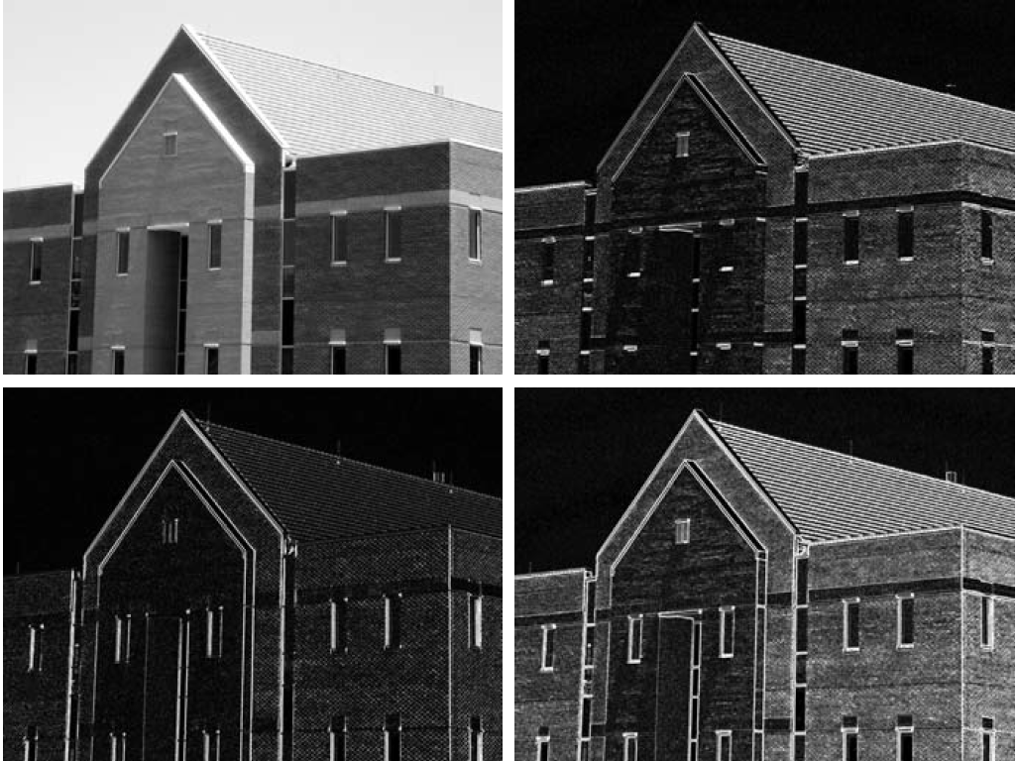
Gradient Operators
Application to raw image sensitive to noise and detail

Slide 16
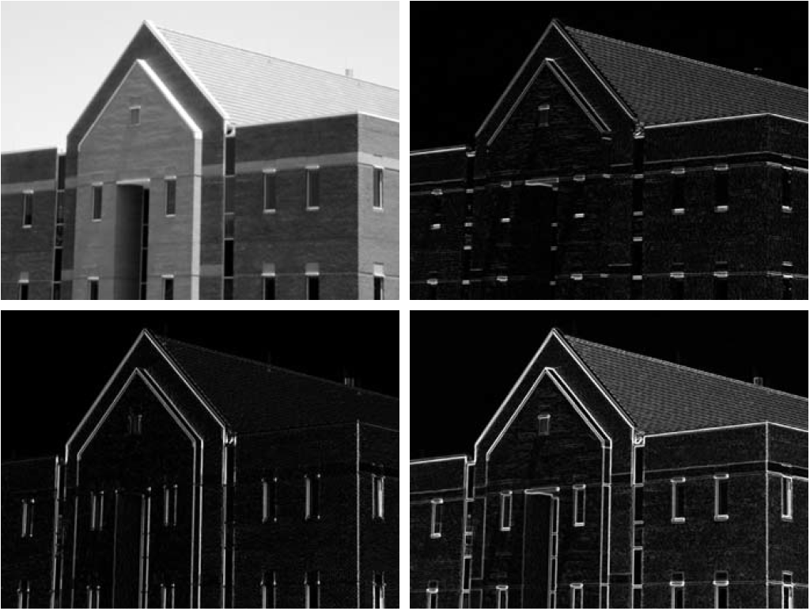
Gradient Operators – Smoothing
Smoothing diminishes sensitivity to noise and detail
5x5
average
filtered

Slide 17
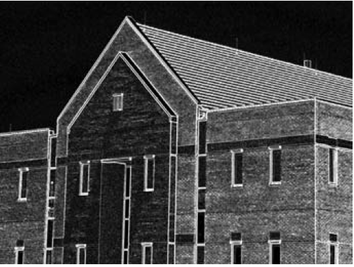
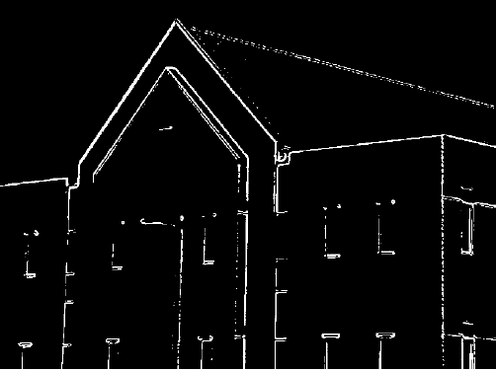
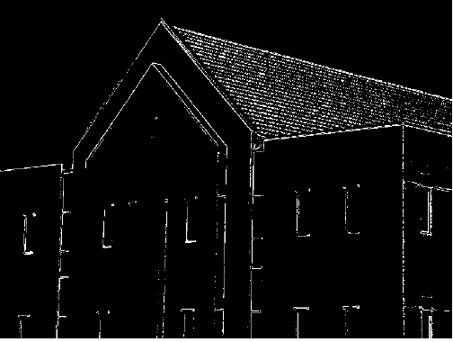
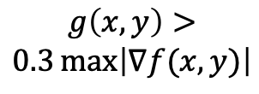
Gradient Operators – Thresholding
$$g\left(x,y\right)>$$
$$0.3\max\left|∇f(x,y)\right|$$
smoothed
+
thresholded

Slide 18
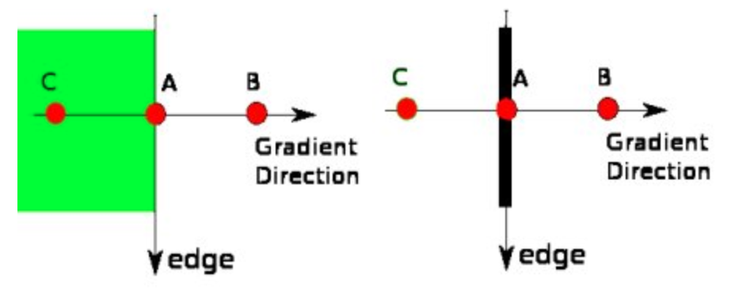
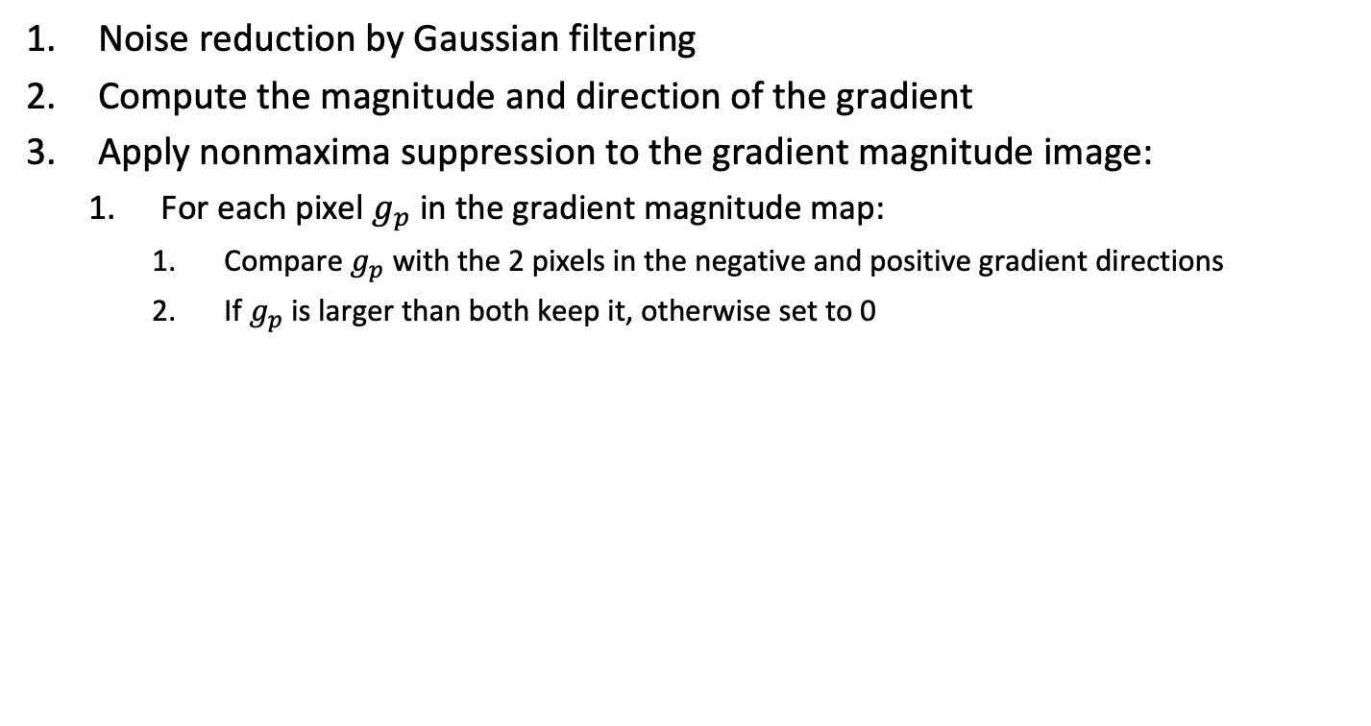
Canny edge detection
Noise reduction by Gaussian filtering
Compute the magnitude and direction of the gradient
Apply nonmaxima suppression to the gradient magnitude image:
For each pixel $g_{p}$ in the gradient magnitude map:
Compare $g_{p}$ with the 2 pixels in the negative and positive gradient directions
If $g_{p}$ is larger than both keep it, otherwise set to 0

Slide 19
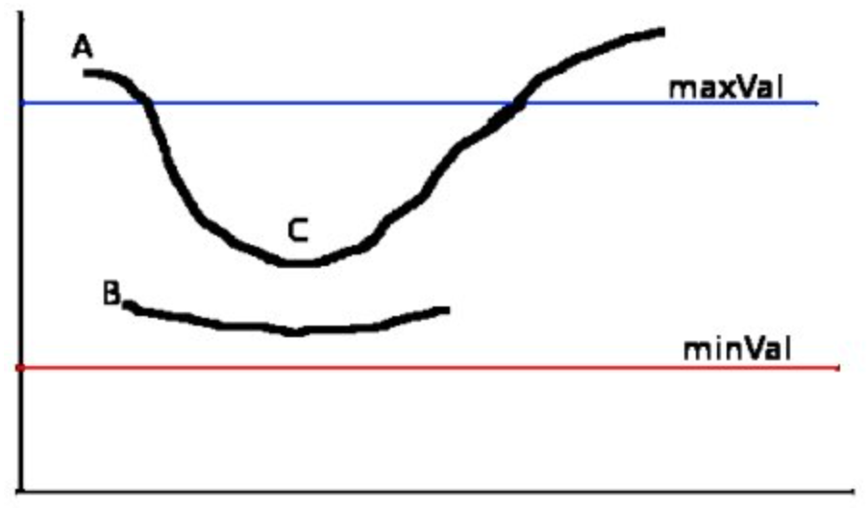
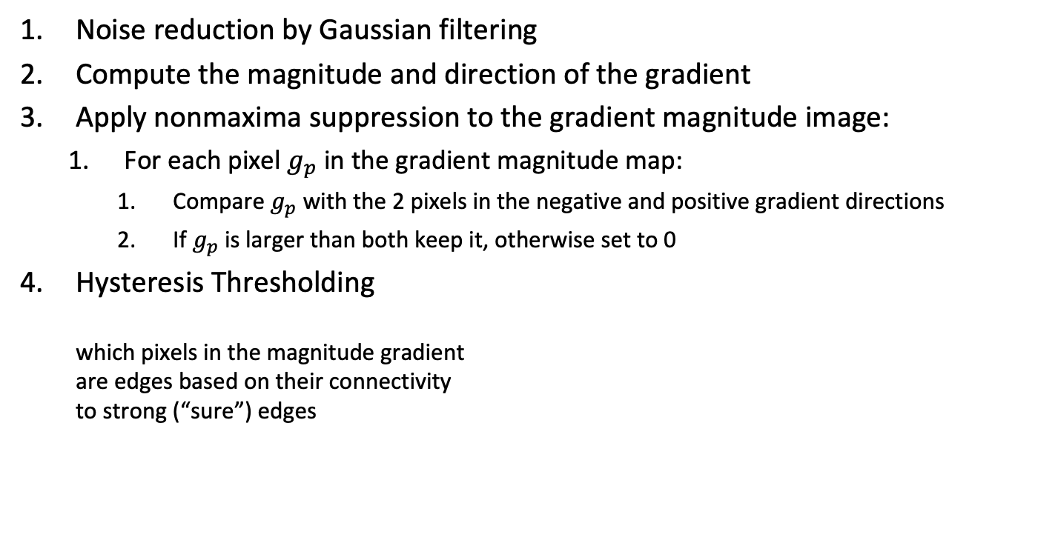
Canny edge detection
Noise reduction by Gaussian filtering
Compute the magnitude and direction of the gradient
Apply nonmaxima suppression to the gradient magnitude image:
For each pixel $g_{p}$ in the gradient magnitude map:
Compare $g_{p}$ with the 2 pixels in the negative and positive gradient directions
If $g_{p}$ is larger than both keep it, otherwise set to 0
Hysteresis Thresholding which pixels in the magnitude gradient are edges based on their connectivity to strong (“sure”) edges
sure
edge
👍
👎
sure
non edge

Slide 20
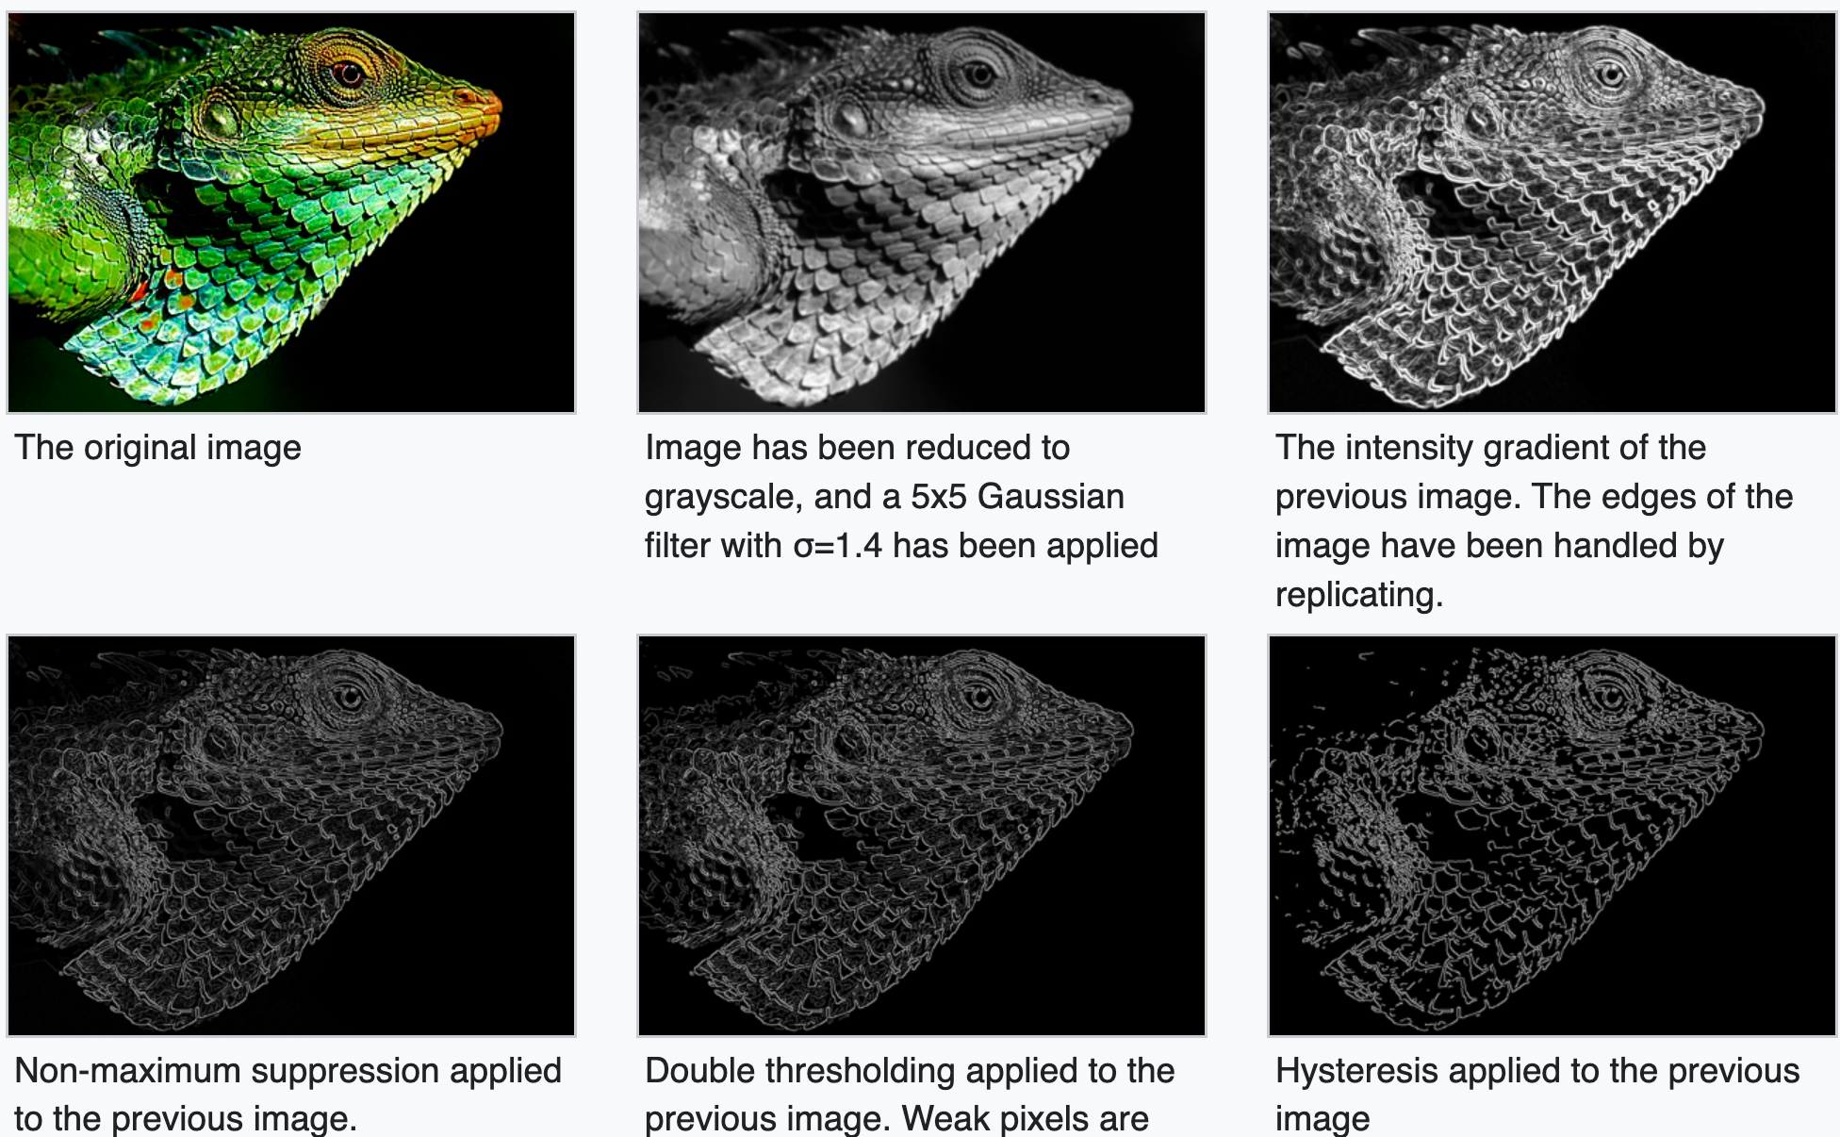
Canny edge detection
https://en.wikipedia.org/wiki/Canny_edge_detector

Slide 21
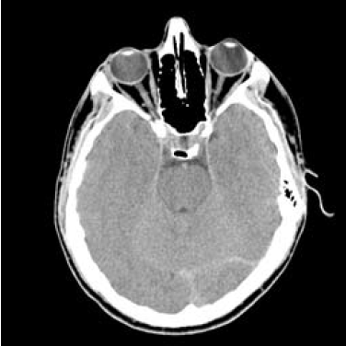
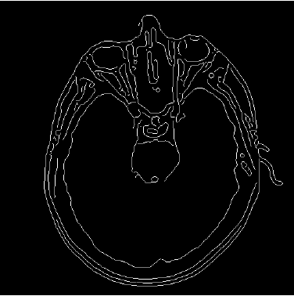
Canny edge detection

Slide 22
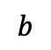
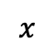
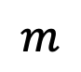
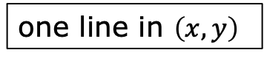
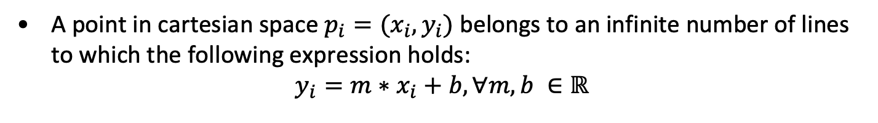
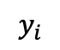
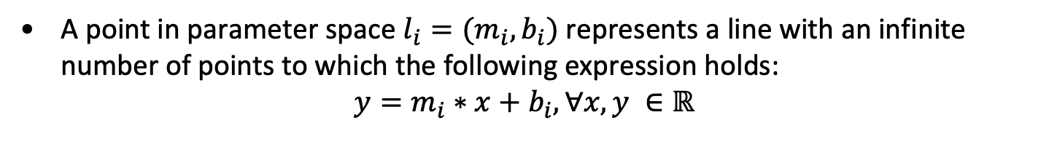
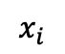
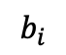
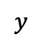
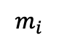
Edge Linking – Hough Transform
A point in cartesian space $p_{i}=(x_{i},y_{i})$ belongs to an infinite number of lines to which the following expression holds:
$$y_{i}=m∗x_{i}+b, ∀m,b ∈ℝ$$
$$y$$
$$b$$
one line in $\left(x,y\right)$
$$y_{i}$$
$$b_{i}$$
$$x_{i}$$
$$x$$
$$m_{i}$$
$$m$$
A point in parameter space $l_{i}=(m_{i},b_{i})$ represents a line with an infinite number of points to which the following expression holds:
$$y=m_{i}∗x+b_{i}, ∀x,y ∈ℝ$$

Slide 23
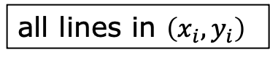

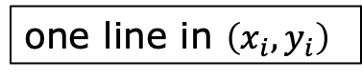




Edge Linking – Hough Transform
Since $m$ approaches $∞$ as lines approach the vertical, polar coordinates are used instead:
$$r=x_{i}∗\cos{θ}+y_{i}∗\sin{θ}$$
where the parameters $\left(r,θ\right)$ represent all lines passing in $\left(x_{i},y_{i}\right)$
For an image $\left(r,θ\right)$ are discretized and positive ($θ∈\left[0,2π\right[$)
$$r$$
one line in $\left(x_{i},y_{i}\right)$
$$r_{i}$$
all lines in $\left(x_{i},y_{i}\right)$
$$θ_{i}$$
$$θ$$

Slide 24


Edge Linking – Hough Transform

Slide 25




Edge Linking – Hough Transform

Slide 26




Edge Linking – Hough Transform
The Hough transform can be applied to other curves described in closed analytical form.
For example the circle: ${\left(x−x_{c}\right)}^{2}+{\left(y−y_{c}\right)}^{2}=r^{2}$
The time complexity of the algorithm increases with the number of parameters

Slide 27


Thresholding
$$g\left(x,y\right)=\left\{\begin{matrix}1 & ←f(x,y)≥T \\ 0 & ←¬\end{matrix}\right.$$

Slide 28

Thresholding: noise

Slide 29


Thresholding: illumination

Slide 30

Otsu Optimal Global Thresholding
Consider the normalized histogram with $p_{i}={n_{i}}/{\left(M∗N\right)}, i=0,…,L−1$, for an image with $M∗N$ pixels and $L$ illumination levels
A threshold $k$ divides the pixels into 2 classes:
$C_{1}$ containing the pixels with values in $\left\{0,⋯,k\right\}$
$C_{2}$ containing the pixels with values in $\left\{k+1,⋯,L−1\right\}$
Let $P_{1}(k)$ be the probability that a pixel belongs to $C_{1}$
Let $m\left(k\right)=\sum_{i=0}^{k}{ip_{i}}$ be the average intensity of $C_{1}$
Let $m_{G}=\sum_{i=0}^{L−1}{ip_{i}}$ be the average global intensity (whole image)
Then the optimal threshold is given by
$$k=\underset{0≤k<L}{argmax}\left(\frac{{\left[m_{G}P_{1}\left(k\right)−m(k)\right]}^{2}}{P_{1}(k)\left[1−P_{1}(k)\right]}\right)$$

Slide 31



Otsu Optimal Global Thresholding

Slide 32


Thresholding: smoothing noise
5x5 smoothing filter

Slide 33

Thresholding: Edges
Select the threshold using the edges’ pixels instead of all pixels:
$ℒ\left(x,y\right)=\left|∇^{2}f\left(x,y\right)\right|$
$ℒ_{TG}\left(x,y\right)=\left\{\begin{matrix}0 & ←ℒ\left(x,y\right)<TG \\ 1 & ←¬\end{matrix}\right.$ // mask strong edges
$f_{TG}\left(x,y\right)=\left\{\begin{matrix}0 & ←ℒ_{TG}\left(x,y\right)=0 \\ f\left(x,y\right) & ←ℒ_{TG}\left(x,y\right)=1\end{matrix}\right.$ // select strong edges
$T=Otsu\left(f_{TG}\right)$
$f_{T}\left(x,y\right)=\left\{\begin{matrix}0 & ←f\left(x,y\right)<T \\ 1 & ←¬\end{matrix}\right.$ // threshold the original image

Slide 34






Thresholding: Edges
$$f$$
$$ℒ_{TG}$$
$$f_{TG}$$
$$f_{T}$$

Slide 35

Local Thresholding
Select a per pixel threshold $T\left(x,y\right)$
Most commonly
$$T\left(x,y\right)=a∗σ\left(x,y\right)+b∗m(x,y)$$
or
$$T\left(x,y\right)=a∗σ\left(x,y\right)+b∗m_{G}$$
$m_{G}$ - mean image value
$m(x,y)$ – mean value in a neighbourhood of $(x,y)$
$σ\left(x,y\right)$ – standard deviation in a neighbourhood of $(x,y)$

Slide 36


Local Thresholding

